Slide 1
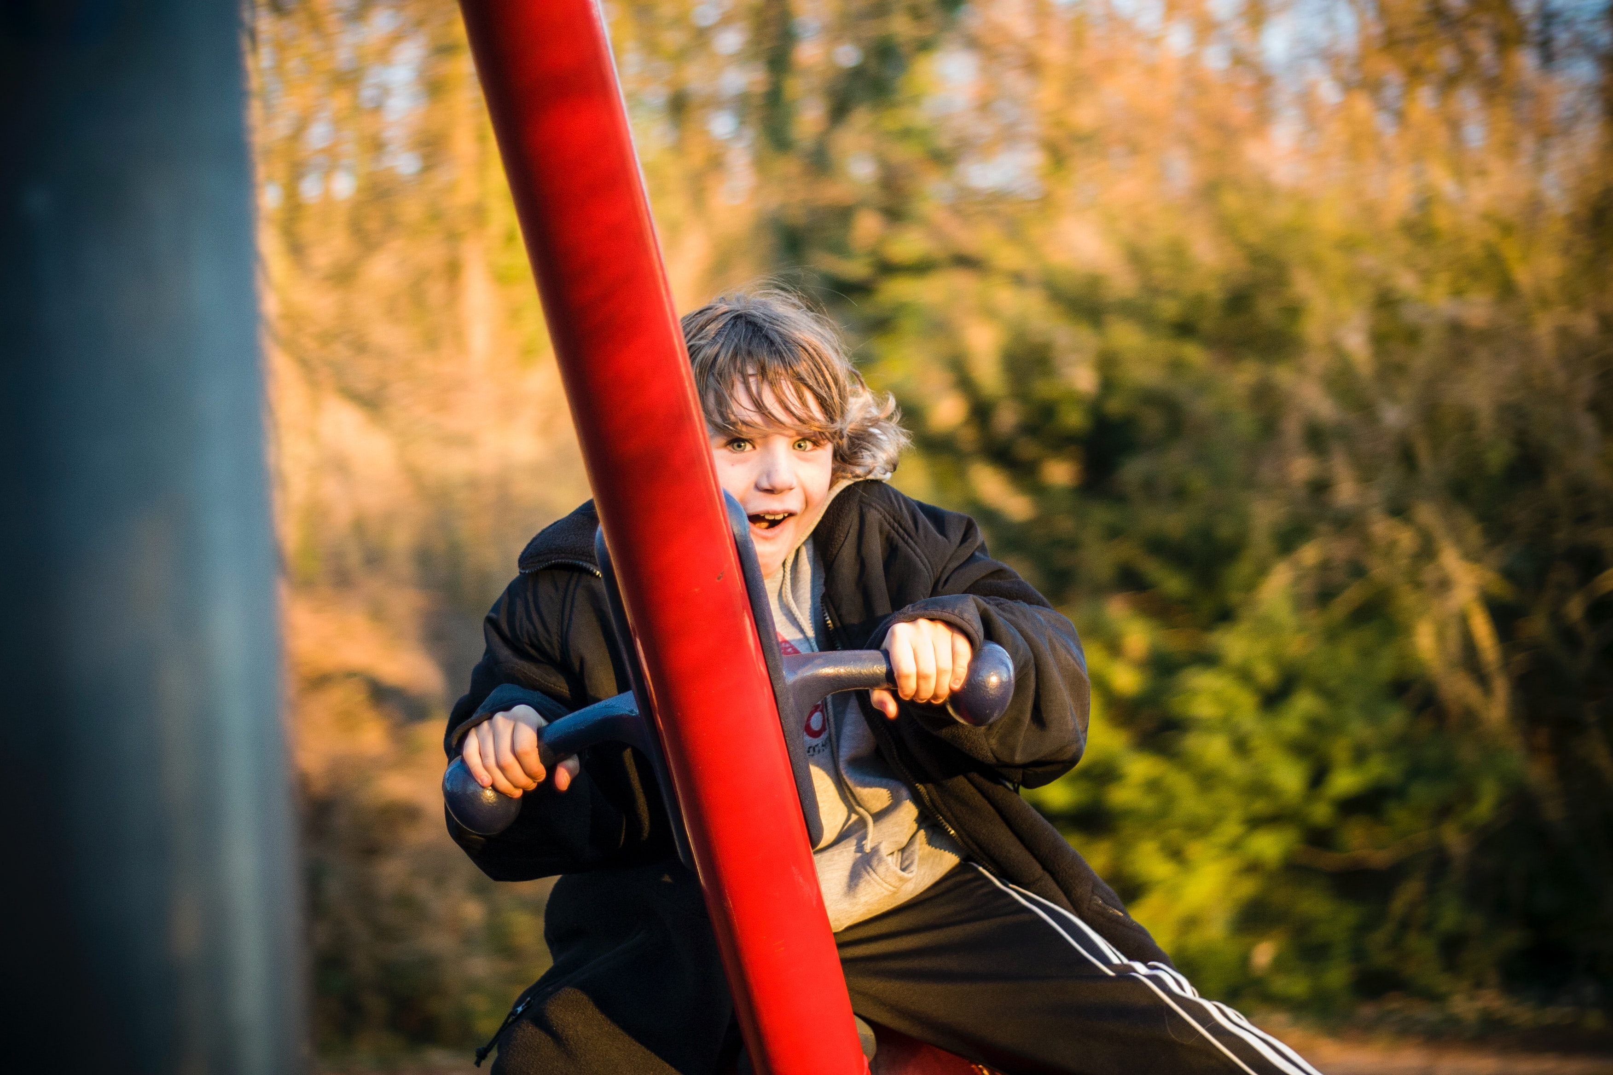
Children’s Week 2024
Members Advocacy Kit.

Slide 2

‘
The Children's Week National Theme for 2024 is based on UNCRC Article 24:
Children have the right to a clean and safe environment.
Notes:
10 minutes on this and next slide

Slide 3
The Committee interprets children’s right to health as defined in article 24 as an inclusive right, extending not only to timely and appropriate prevention, health promotion, curative, rehabilitative and palliative services, but also to a right to grow and develop to their full potential and live in conditions that enable them to attain the highest standard of health through the implementation of programmes that address the underlying determinants of health. A holistic approach to health places the realization of children’s right to health within the broader framework of international human rights obligations.
General comment No. 15 (2013) on the right of the child to the enjoyment of the highest attainable standard of health (art. 24)* https://www.refworld.org/docid/51ef9e134.html
This is what Article 24 in the UNCRC actually in todays context:

Slide 4
because of climate change, children living today will confront even greater health risks over their lifetime, with available estimates indicating a 30-100% increase across selected health risks by 2050. Future generations may face a 3 to 15-fold increase by 2100.
Strazdins, L., Friel, S., McMichael, T., Woldenberg Butler, S., & Hanna, L. (2010). Climate change and child health in Australia: Likely futures, new inequalities? International Public Health Journal, 2(4), 493-500. http://hdl.handle.net/1885/38778
And the evidence is present….:

Slide 5
OUR 4 KEY MESSAGES FOR CHILDREN’S WEEK 2024:
Play is not optional, but essential for healthy human development.
Play is a preventative health strategy
Children’s access to play space is an essential consideration in urban planning.
Erosion of many natural and public spaces traditionally available to children to play in, creates a need for greater government intervention to protect the rights under article 31.
Notes:
10 minutes on this and next slide

Slide 6
ACTION YOU CAN TAKE…
Children’s Week 2024.
(
Share Social media posts with hash tags.
Attend a Children’s Week event
Contact your local federal and state parliamentary member and tell them why play is important
Include Key messages in your newsletters and links to Play Today Resources
Host a Children’s Week event
Start a conversation.. Share your favourite childhood play memory
Ask your local government what they are doing to recognise the week.
Create a play prompt in your local community .. Like a chalk hopscotch on a footpath
Display the Children’s Week poster in your organisation

Slide 7
‘
Children’s Week Social Media Guidelines
The Children’s Week campaign will be promoted across the Play Australia social media platforms:
Facebook: @PlayAustralia
LinkedIn: @PlayAustralia
Please help us to ensure the campaign gains a wider reach by liking, sharing our posts and commenting, we need traction across the country and social media will help create it !!
When posting about Children’s Week please use the hashtag #Childrensweek2024 #Playtoday AND tag Play Australia, using the handles listed above.
Please let us know if there are particular events/programs/activities you would like Play Australia to help amplify through social media let us know by emailing ceo@playaustralia.org.au
While we can’t guarantee we’ll be able to fulfill all requests, we’ll do our best to accommodate!
Send your photos and what you want written in less than 50 words as this makes it easier for us to post.
Notes:
10 minutes on this and next slide

Slide 8
Children’s Week 2024;
Useful Research and Evidence
We’ve compiled some useful research and evidence links to support your advocacy on the key messages.
There is an abundance of evidence supporting our key messaging..
General comment No. 15 (2013) on the right of the child to the enjoyment of the highest attainable standard of health (art. 24)*
https://www.refworld.org/docid/51ef9e134.html
Children’s Right to Play and the Environment
http://ipaworld.org/wp-content/uploads/2016/05/IPA-Play-Environment-Discussion-Paper.pdf
Play Australia will be issuing a series of social media tiles during Children’s Week containing research facts and evidence to support the key messages.

Slide 9
Children’s Week 2024 campaign FAQ’s
(
Is there cost to be part of Children’s Week?
Children’s Week is a free national community event – you There are no costs involved in taking part in the Children’s Week or the associated Play Australia campaign.
Can I use the Children’s Week Logo?
All Children’s Week campaign assets and guidelines can be used by groups including the Logo for free or low cost events. It cannot be used for marketing products or services Check www.childrensweek.org.au for more guidance.
Council, schools, children’s services and community groups all have immediate access, If in doubt email us.
Can I create my own key messages?
Yes you can, but the key to successful advocacy is clear consistent messaging. As a member of Play Australia we have the opportunity to provide this with your support.
Do I have to run an activity?
No. There are many ways you can contribute to the week. We have provided some ideas in this pack but you may have others – go for it!!
If you require further assistance or advice, please reach out to us at Play Australia

Slide 10


Find more resources to support your advocacy on the Children’s Week website including a poster to display.. www.childrensweek.org.au
www.childrensweek.org.au

Slide 11
Thank you for your support of Australian Children’s Week 2024 !!
Would you like to a member of the Play Australia Children’s Week working party for 2025?
We would love to hear from you!
Email Robyn ceo@playaustralia.org.au www.playaustralia.org.au
Meredith.lamb@peopleandparks.org
Notes:
10 minutes on this and next slide

